Slide 1
Padding + Margin

Slide 2
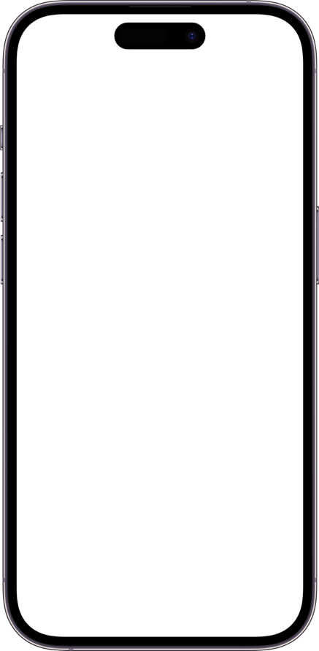
Creating UI Padding
Adds space between a View’s Border and its Content
Some Views Include Default Padding
This is a Label
Key
Left Padding
Right Padding
Top Padding
Bottom Padding

Slide 3
Creating UI Margin
Adds space between a View’s invisible outer border and its visible Border
Some Views Include Default Margin
This is a Label
Key
Left Margin
Right Margin
Top Margin
Bottom Margin

Slide 4
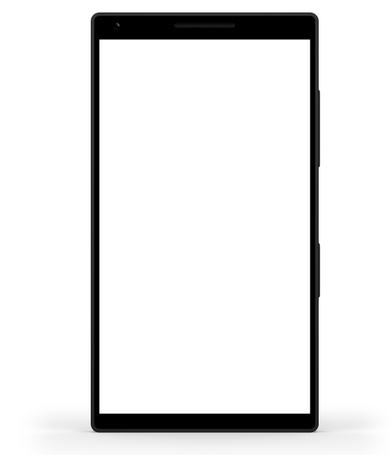
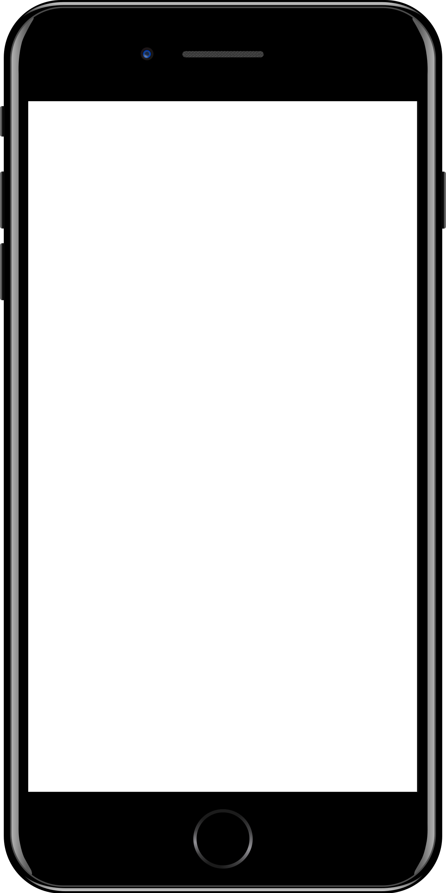
Sample mobile app slide
iPhone 7/8
iPhone 14
Generic phone
(BrandCentral)
App screenshots can be placed behind these transparent .pngs

Slide 5
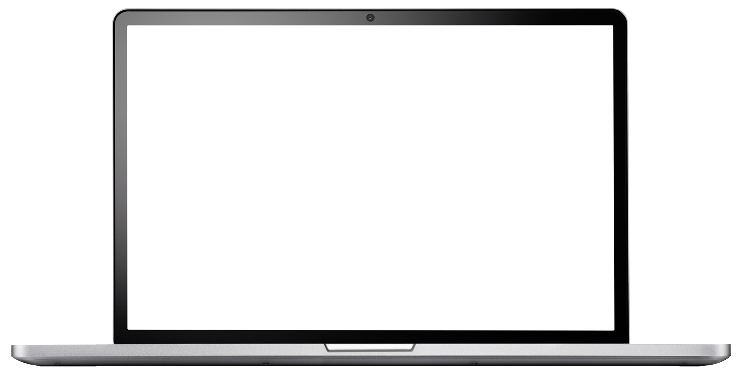
Sample website slide (blank)
Website screenshots can be placed behind this transparent .png

Slide 6
Bullet points layout with subtitle Subtitle is smaller in the same text block
Example of a bulleted slide with a subhead
Set the slide title to “Sentence case”
Set subheads to “Sentence case”
Hyperlink style
www.microsoft.com

